Slide 1


Protecting your apps and services using Azure AD workload identities
MC2MC
Women in Tech
April 2022

Slide 2



About me
Shannon Kuehn (KEEN)
Identity and Network Access Advocacy Team
Senior Program Manager
@shankuehn
https://www.linkedin.com/in/shannonkuehn/

Slide 3







The Advocacy team is looking for tech influencers.
Live Streamers
Content Creators
Social Media Influencers
Bloggers
Learn More: https://425show.com
Contact: 425show@microsoft.com

Slide 4
Workload Identities

Slide 5
Taxonomy of identities in Azure AD
Employees
Human identities
External users
Service accounts
Non-human identities
Devices
Internet of Things
Applications, service principals, managed identities, scripts
Workloads

Slide 6

What are workload identities?
Definition: A workload identity is an identity used by a software workload (such as an application, service, script, or container) to authenticate and access other services and resources.
In Azure Active Directory (Azure AD), workload identities are:
An application
A service principal
A managed identity

Slide 7




How are workload identities used?
Here are some ways that workload identities in Azure AD are used:
Web app
Key Vault
Azure Storage
GitHub – CICD Pipeline

Slide 8



Challenges of managing and securing workload identities
Many traditional IAM capabilities do not apply to workload identities
Difficult to manage lifecycle:
How to get a visibility into the activity of workload identities, that enables periodic cleanup
Higher potential for secrets or credentials to leak:
How to ensure that workload identities are not breached
Lacking capabilities for securing access:
How to remove unnecessary or overprivileged access

Slide 9
Do any of the following apply?
Heavy app/workload identity integration with Azure AD
Currently using Azure AD Conditional Access, Identity Protection, or Access Reviews to secure users
Want to protect identities from compromise
Subject to regulations and auditor visits

Slide 10
Introducing 4 new capabilities to protect workloads
Conditional Access for workload identities
Identity Protection for workload identities
Access Reviews for workload identities
Workload Identity Federation

Slide 11
Conditional Access for workload identities

Slide 12
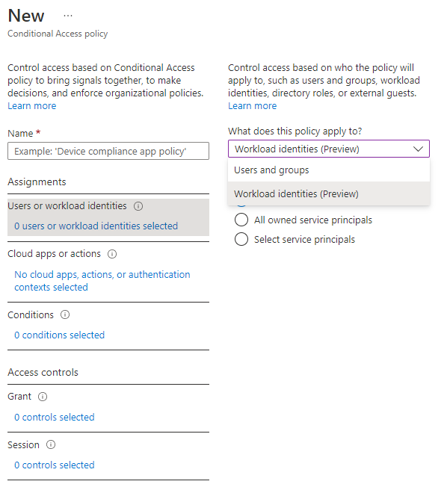
Conditional Access for workload identities
Extend Conditional Access policies to apps and service principals
Restrict access from named locations and Azure Virtual Networks
View service principals blocked by policies using Insights and Reporting workbook
Public Preview

Slide 13
Creating a Conditional Access policy for workload identities

Slide 14
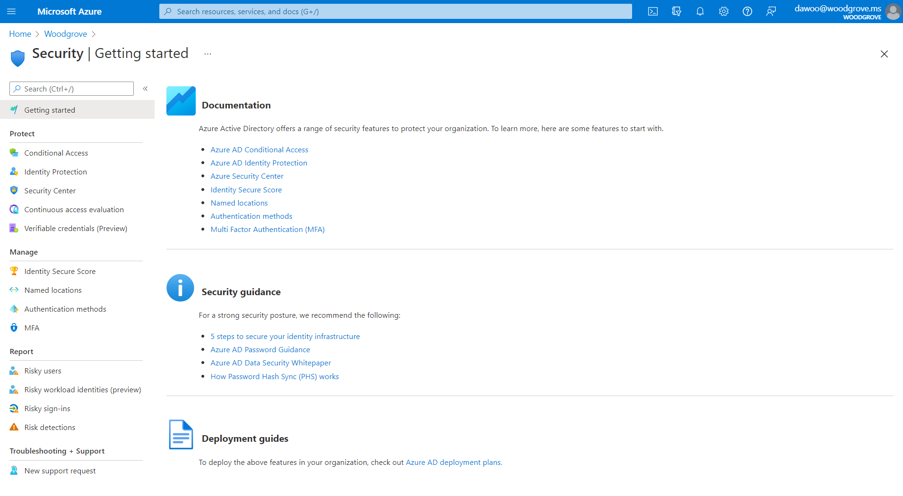

Slide 15
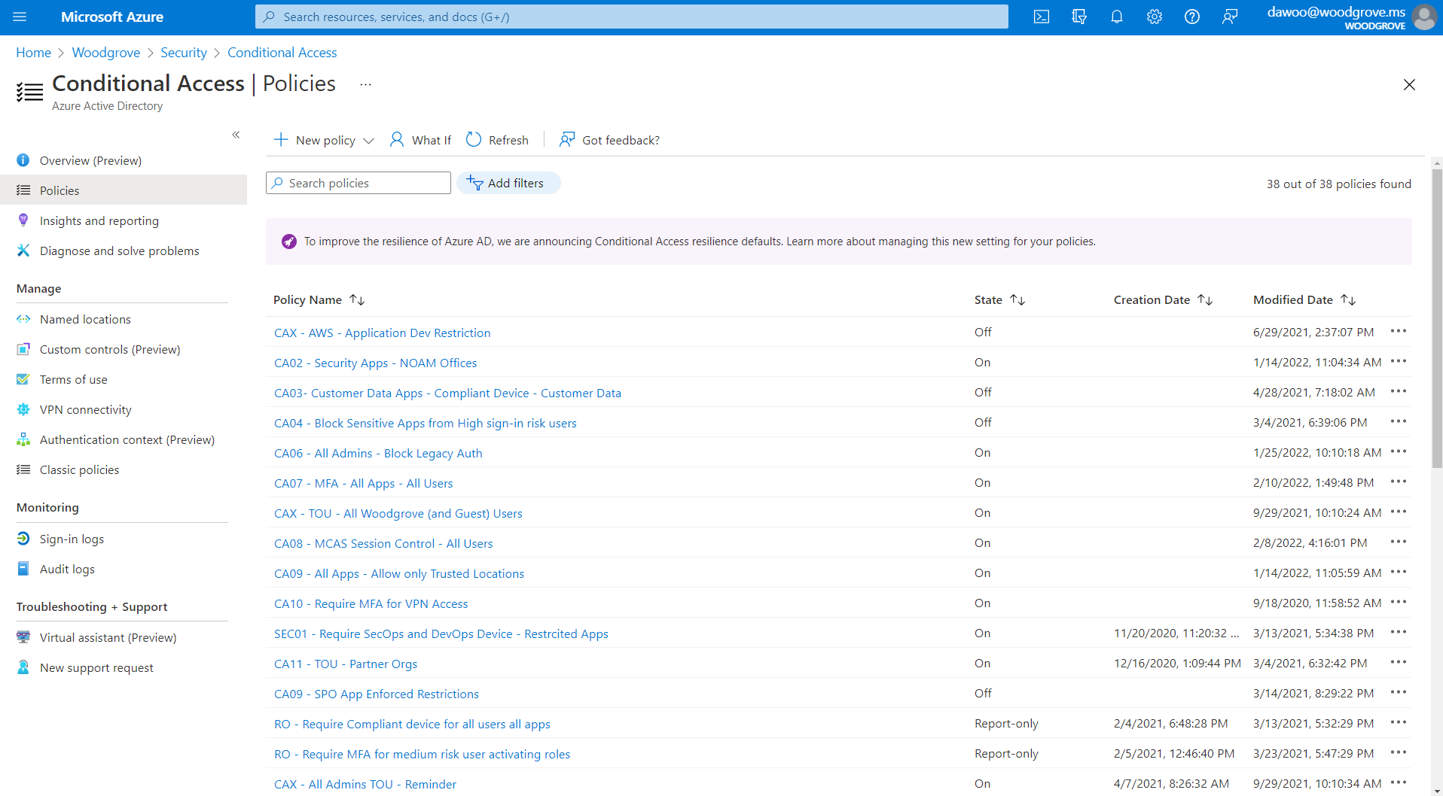

Slide 16
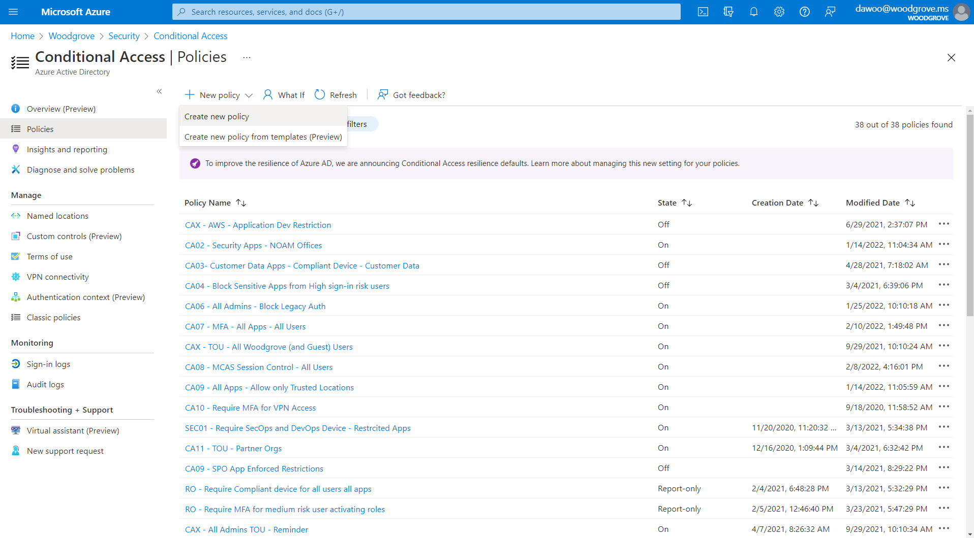

Slide 17
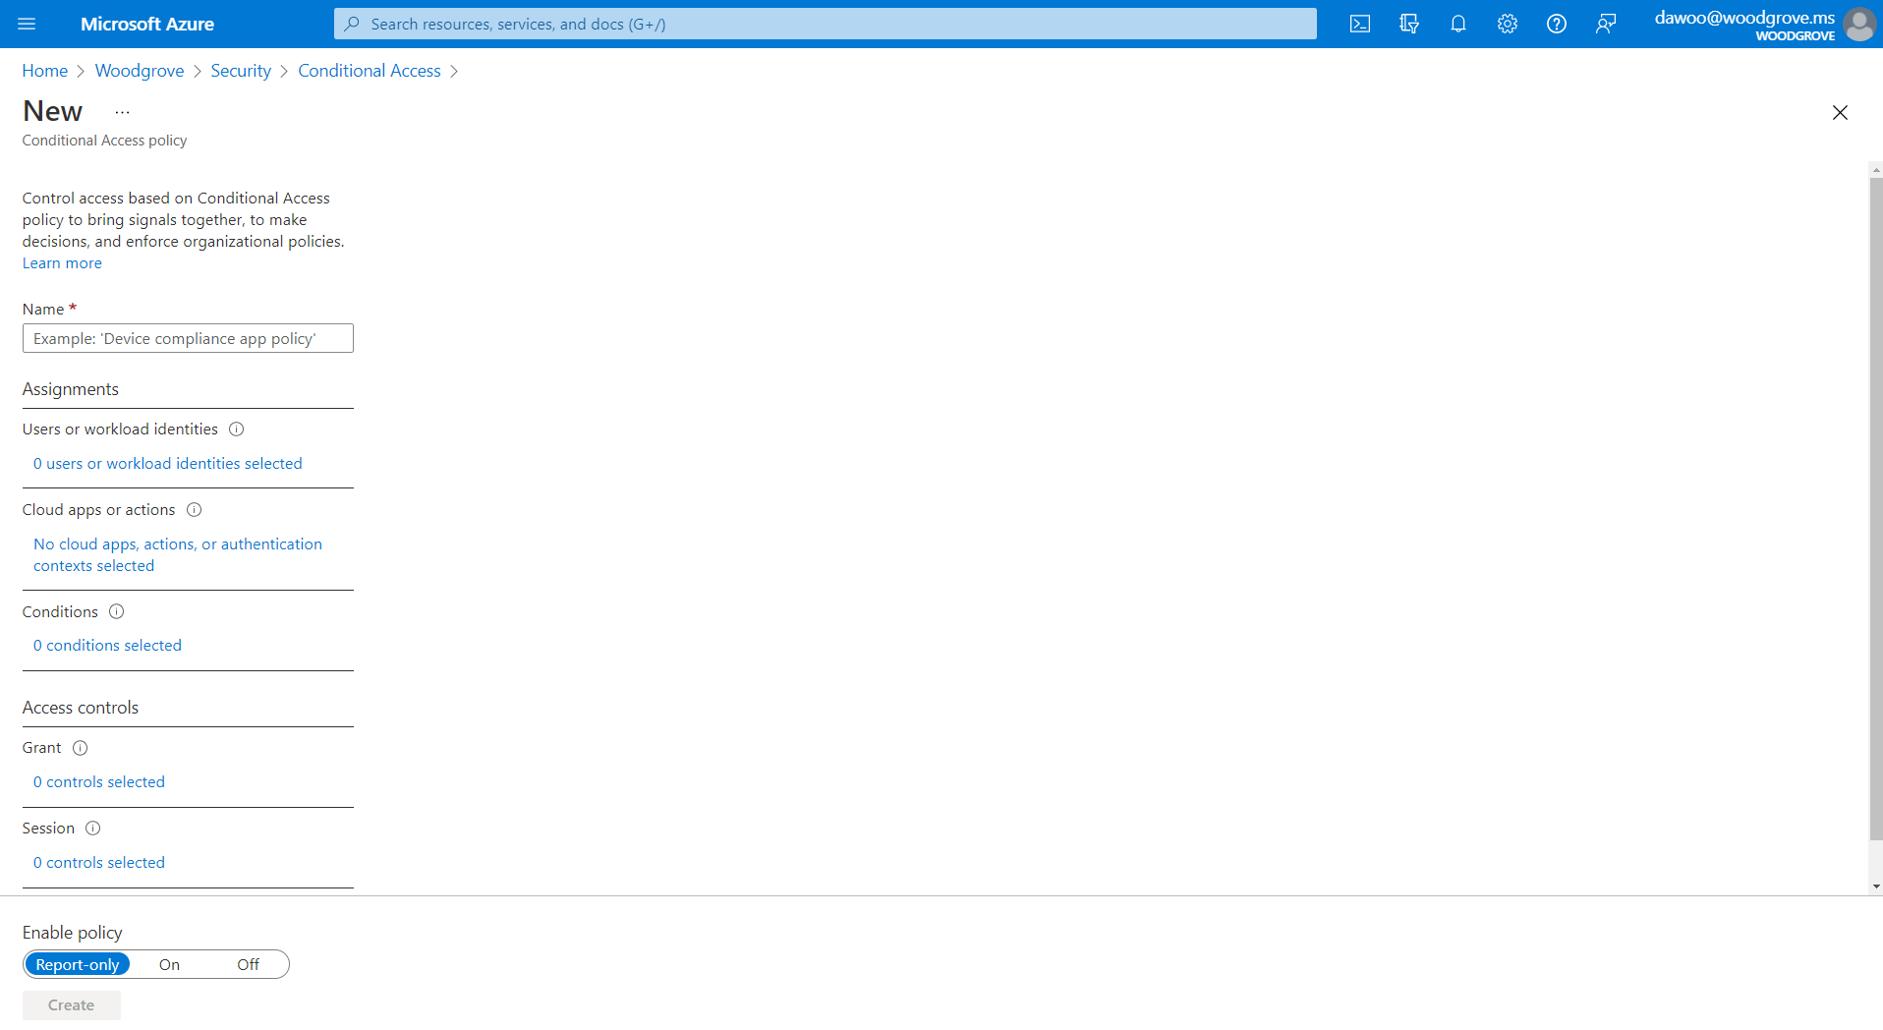
Configure policy assignment

Slide 18
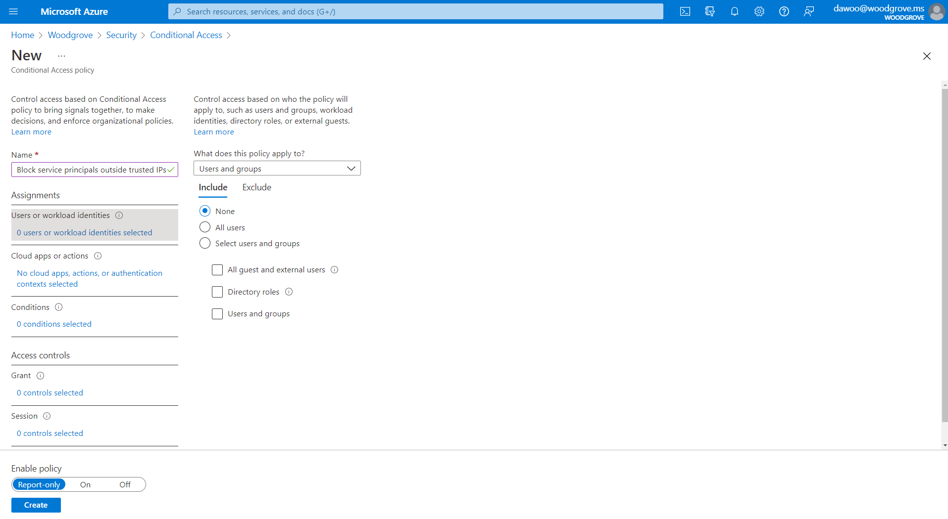

Slide 19
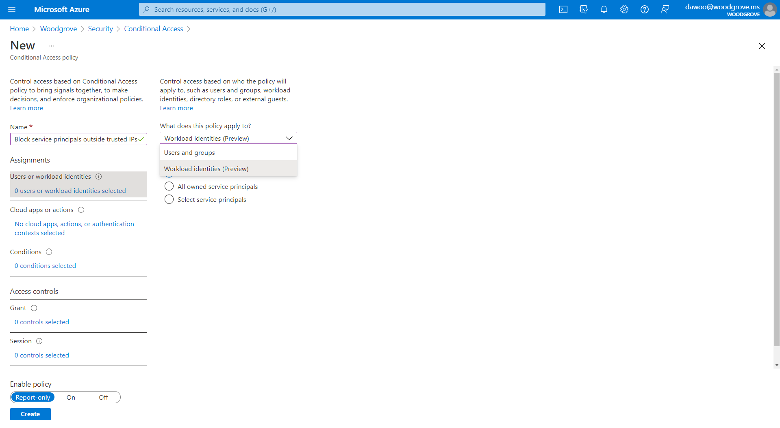
Apply policy to workload identities

Slide 20
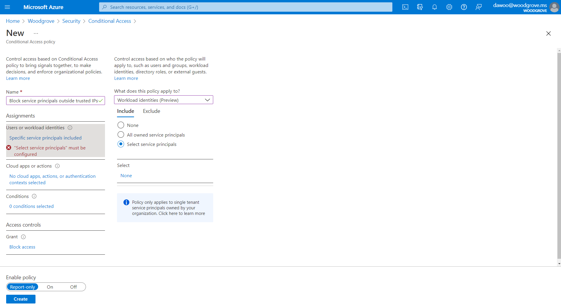

Slide 21
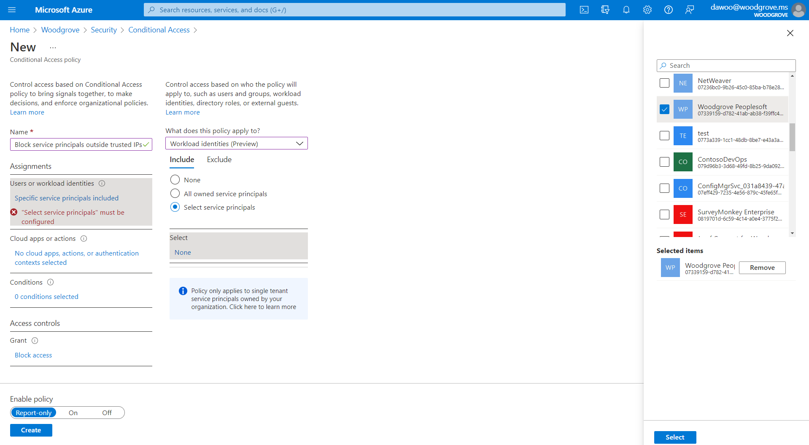
Select apps/service principals the policy should apply to

Slide 22
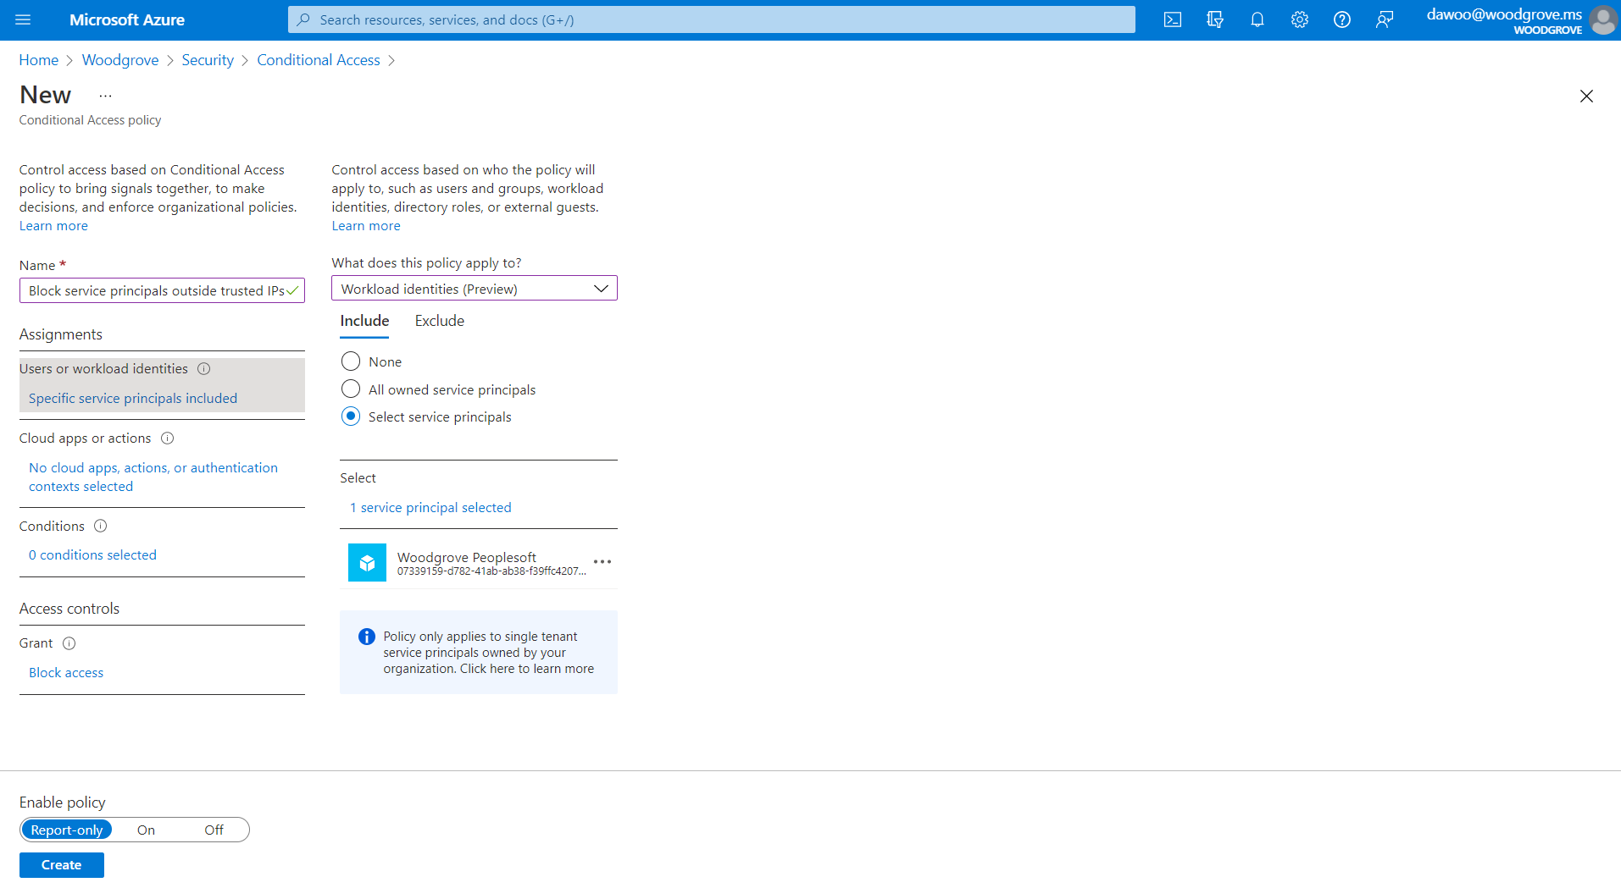

Slide 23
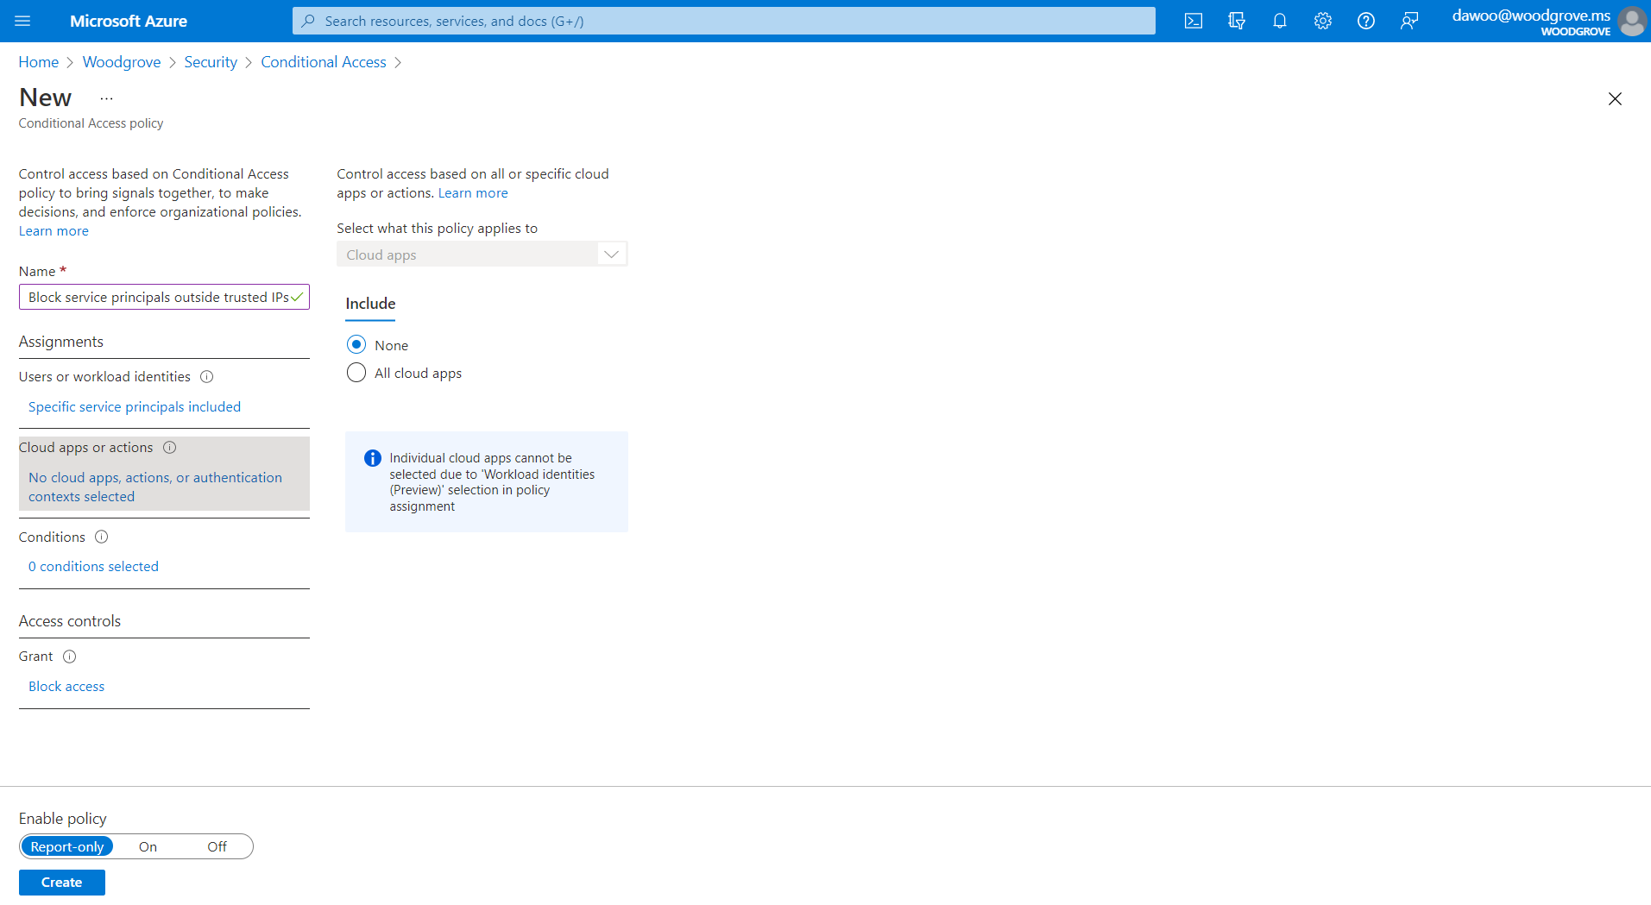
Configure target applications the policy should apply to

Slide 24


Slide 25
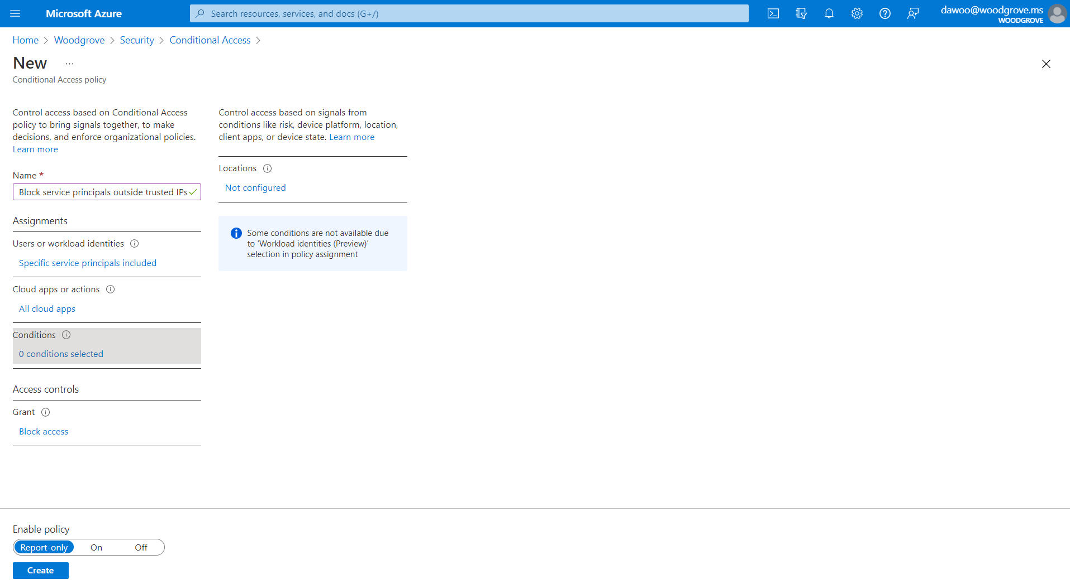
Configure conditions under which policy will apply

Slide 26
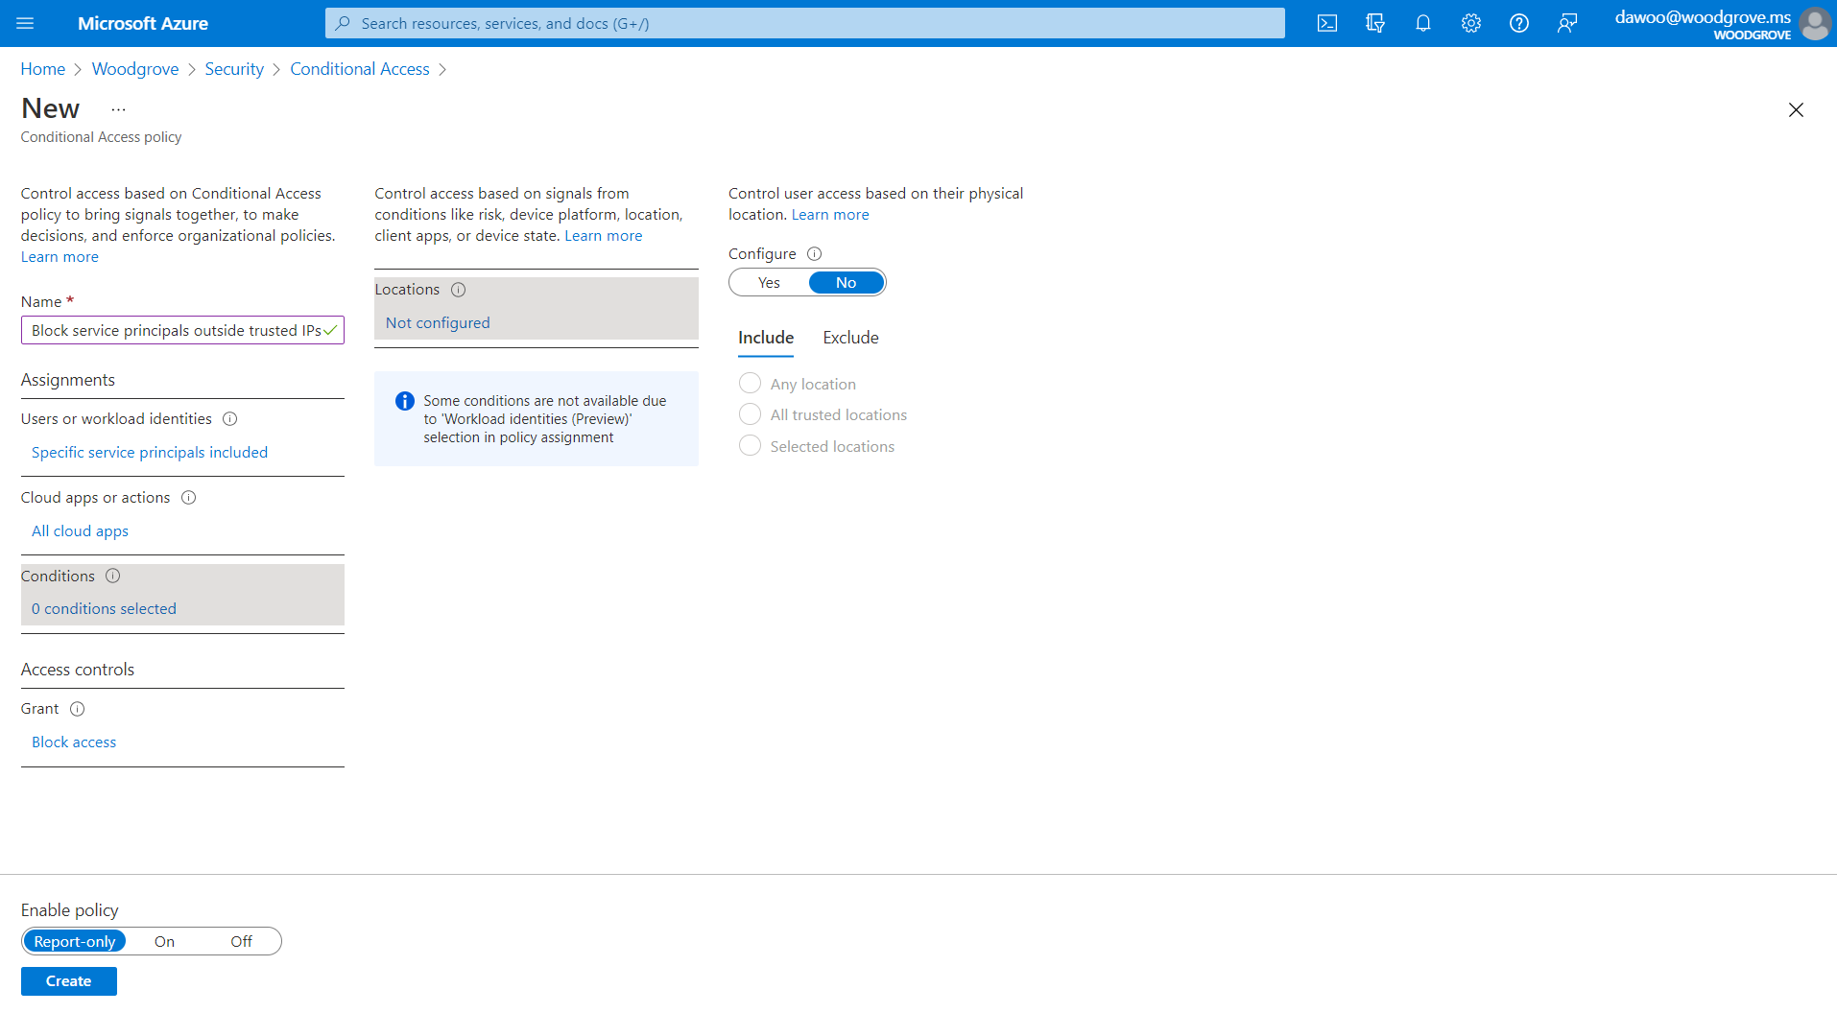

Slide 27
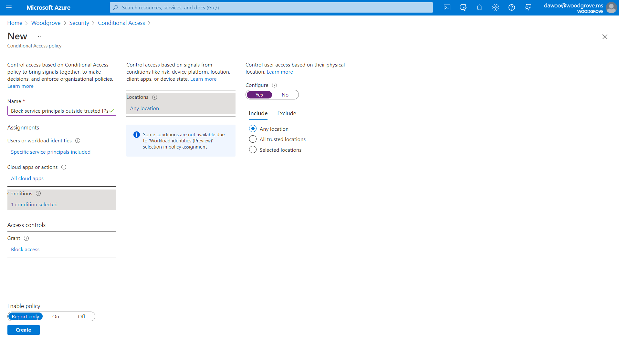

Slide 28
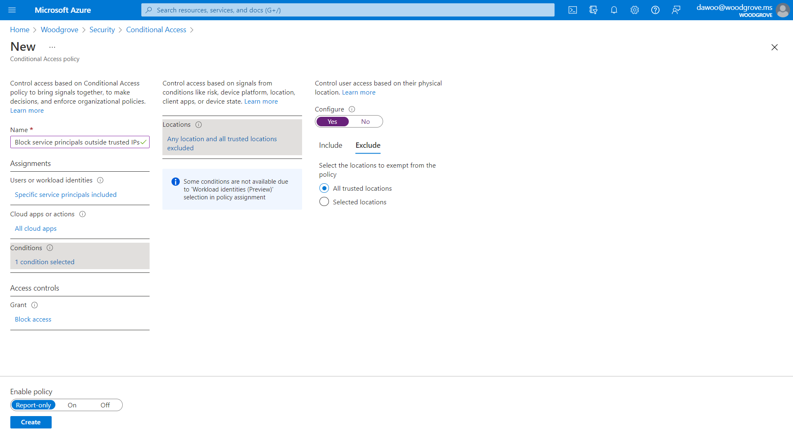

Slide 29
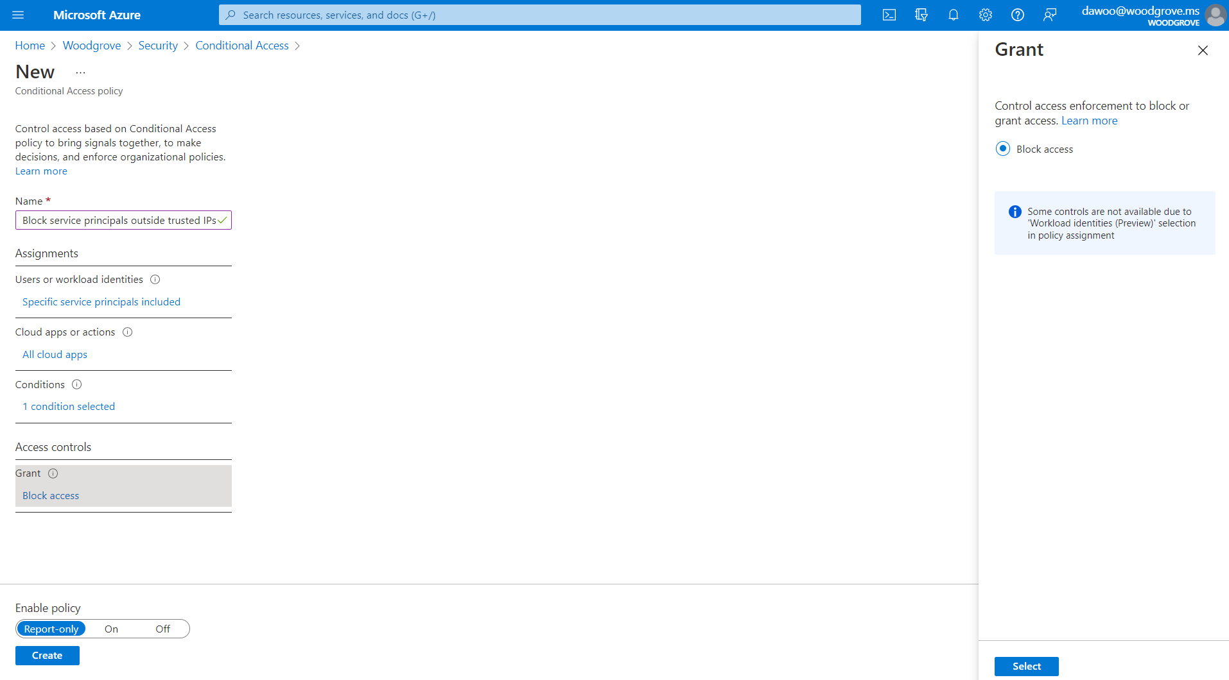
Configure controls that will be enforced when policy applies

Slide 30

Enable policy

Slide 31
Insights and Reporting workbook supports workload identities

Slide 32
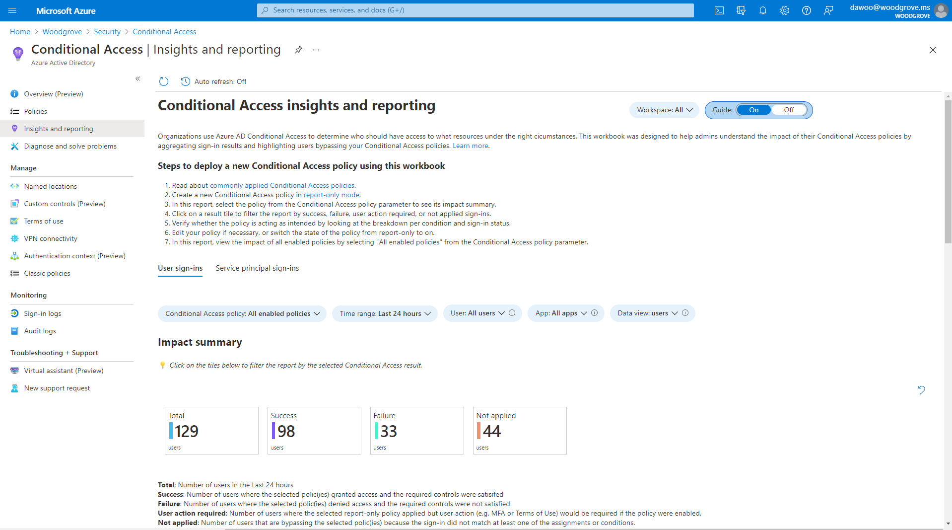
Getting started guide

Slide 33
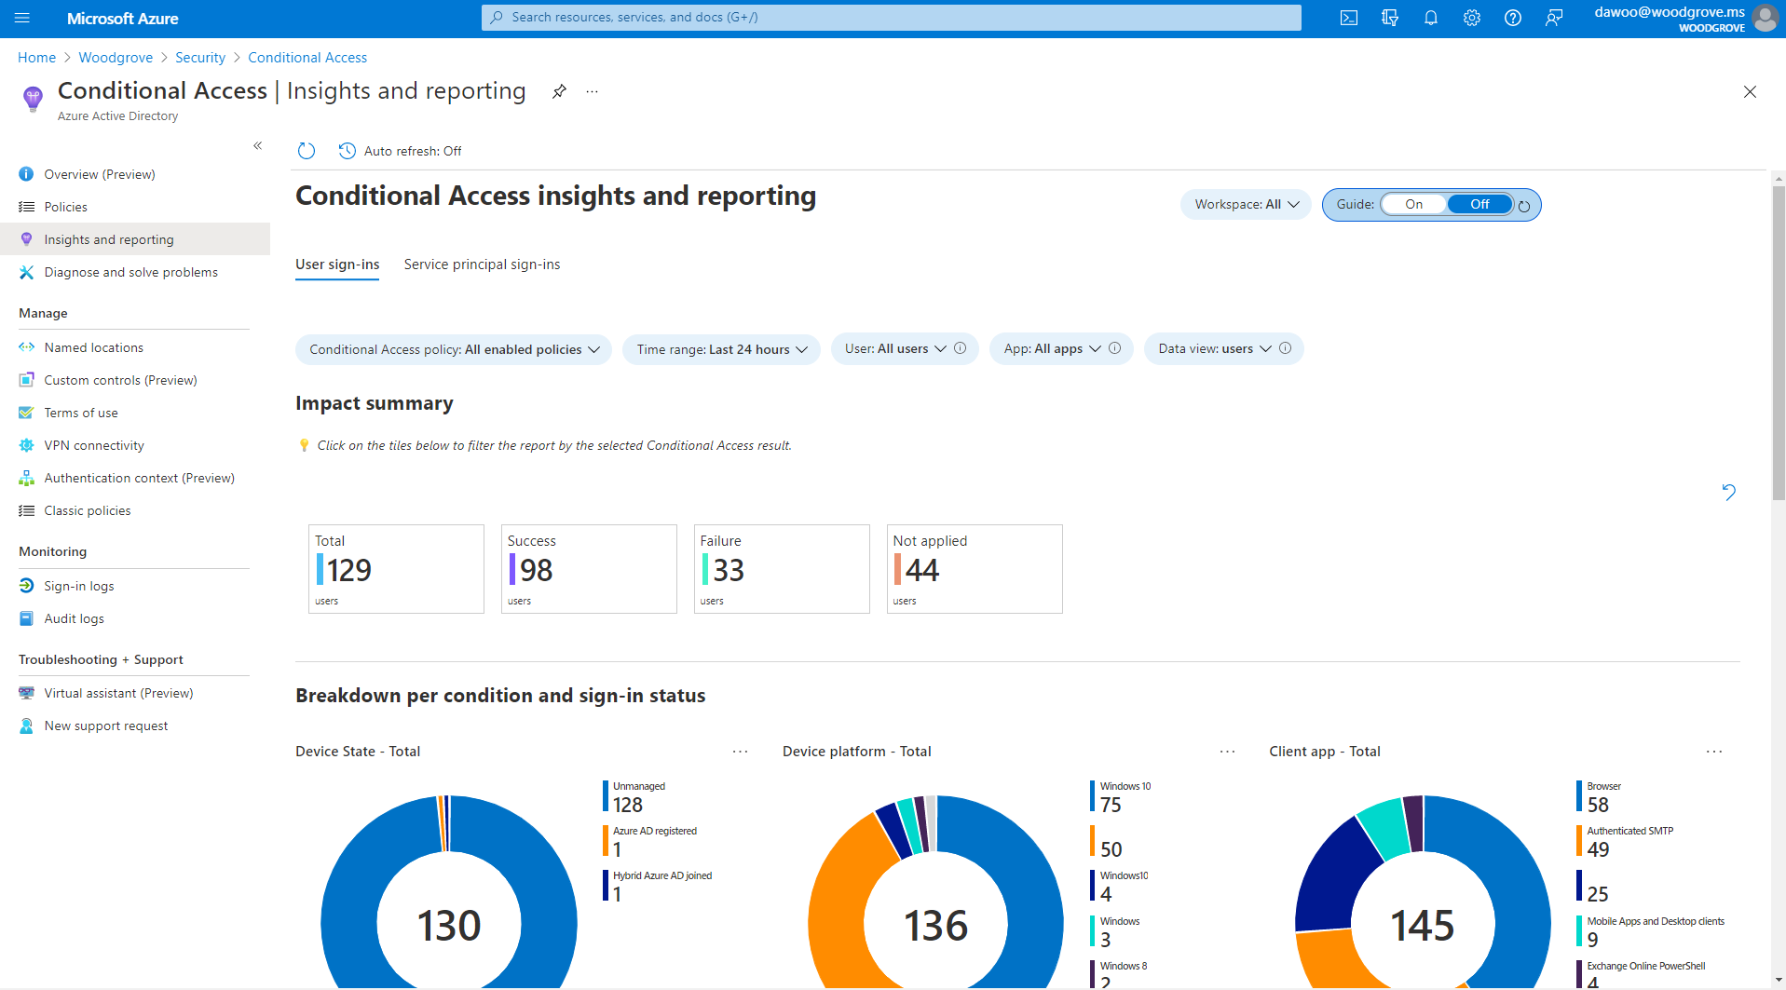

Slide 34
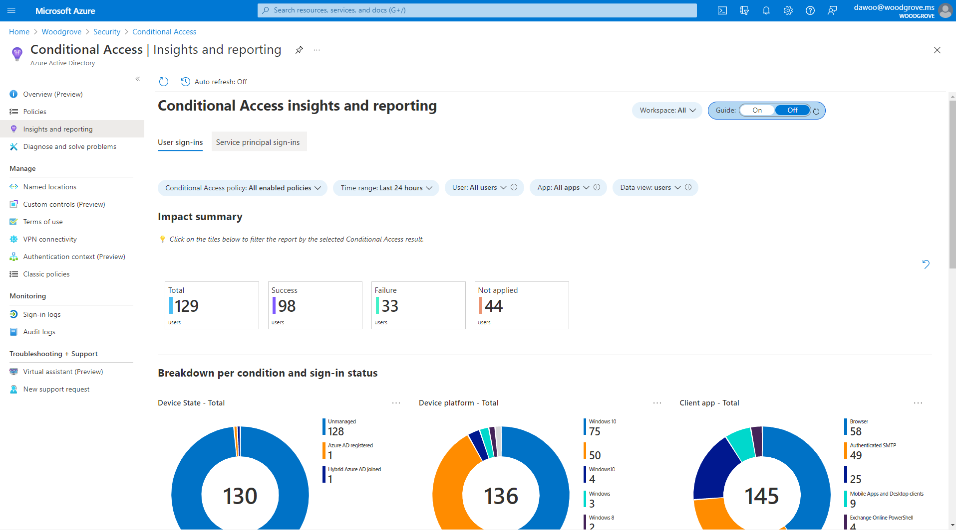

Slide 35
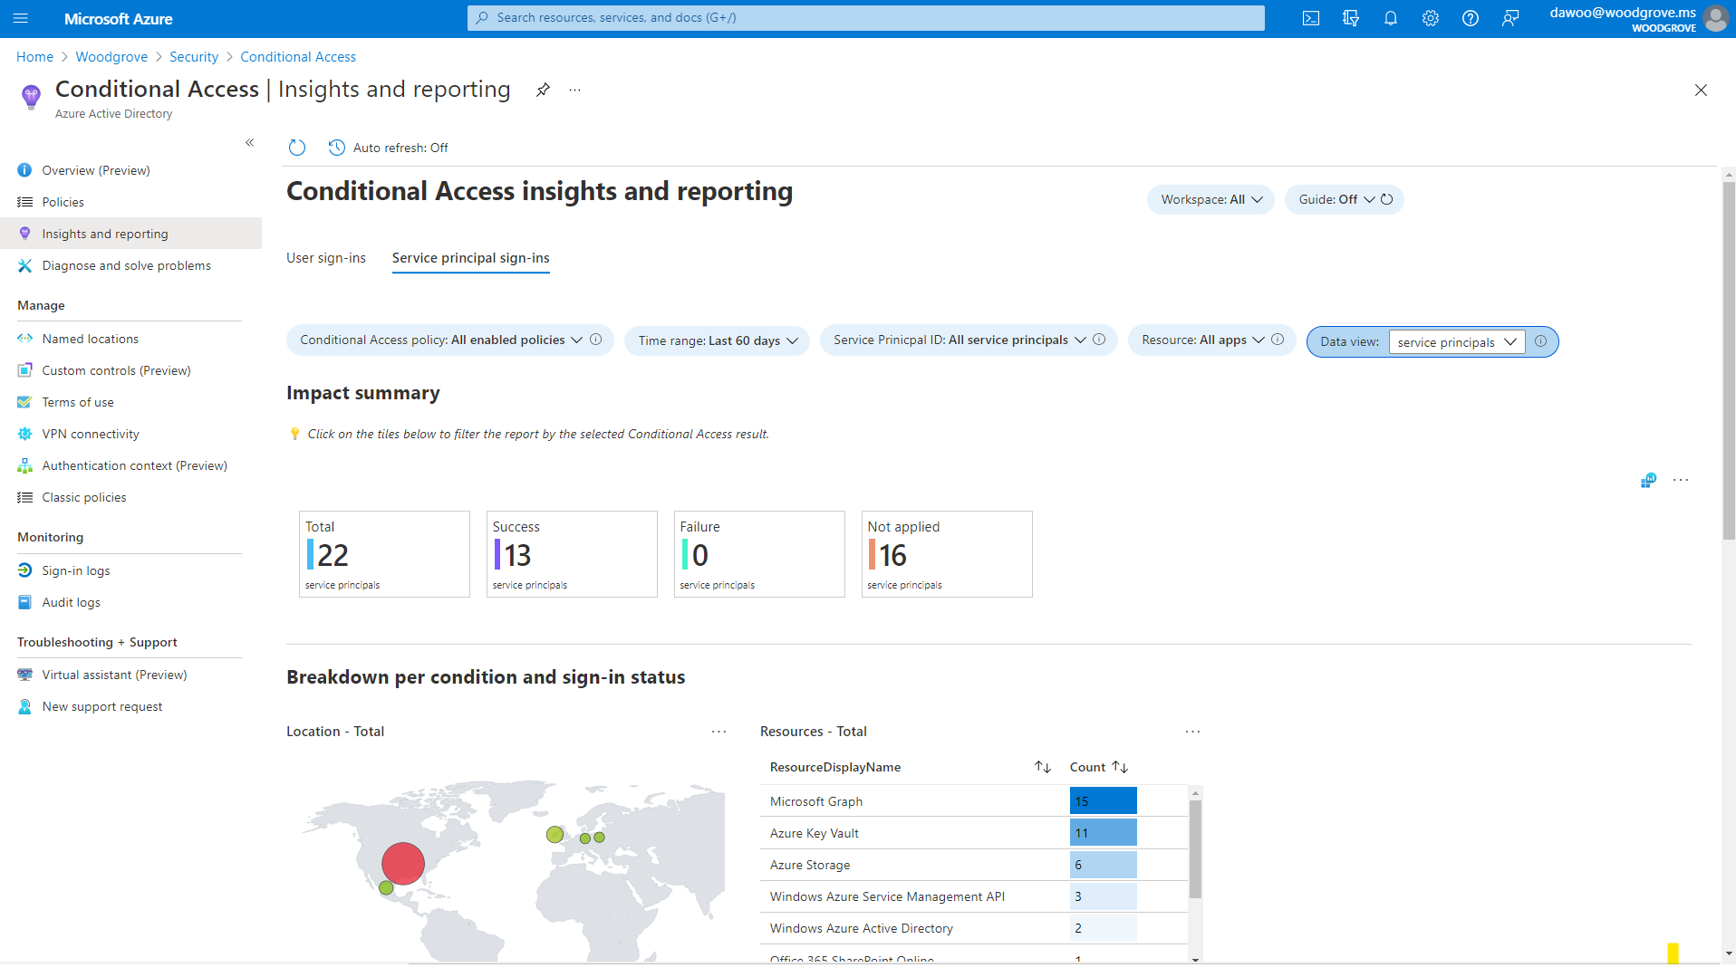

Slide 38
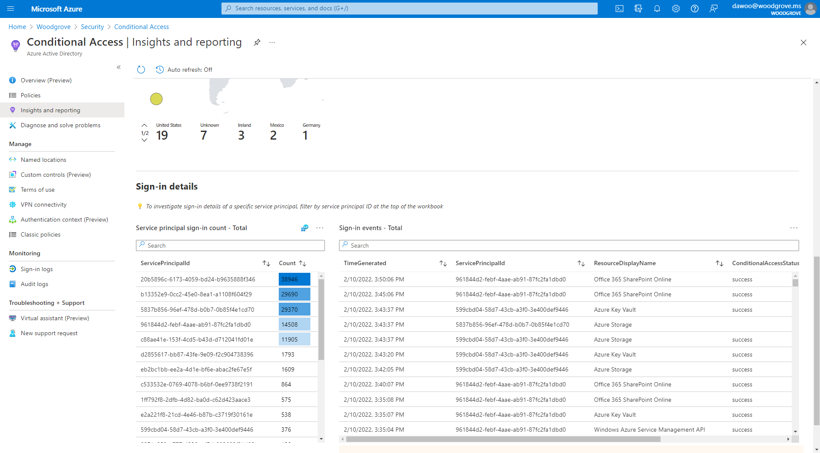

Slide 39
Identity Protection for workload identities

Slide 40
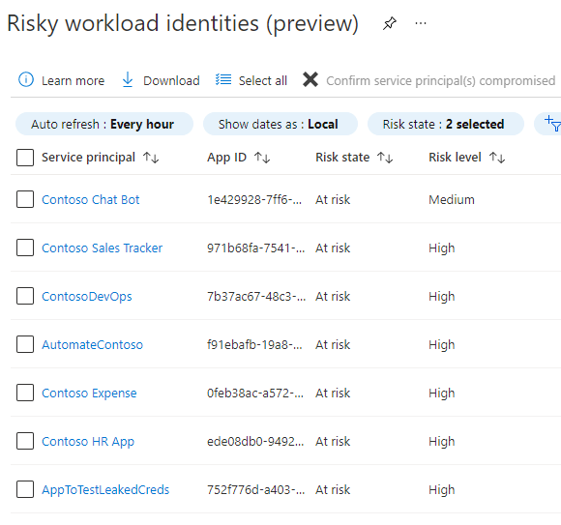
Identity Protection for workload identities
Detect compromised apps and service principals
Block access on risky workload identities in Conditional Access
Export risk logs using Diagnostic Settings (e.g., for SIEM tools)
Public Preview

Slide 41
Identify risky workload identities

Slide 42
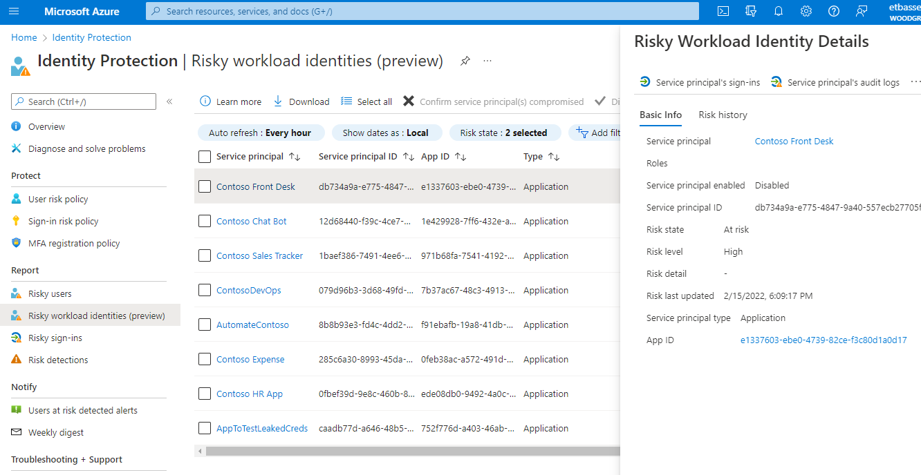
This is account-level risk, similar to Risky Users

Slide 43
Many similar properties, with a few key differences

Slide 44
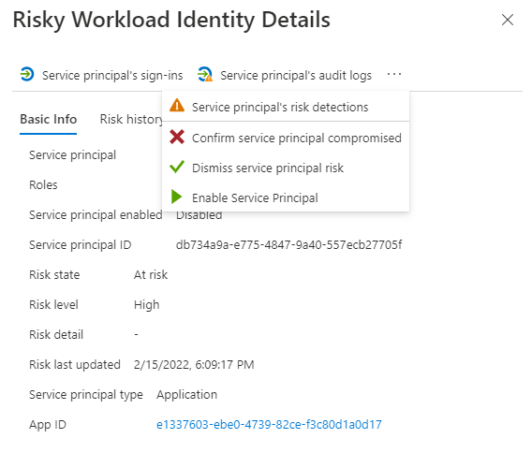
Investigate logs and detection events.
Confirm/dismiss risk. Disable/enable the account.

Slide 45
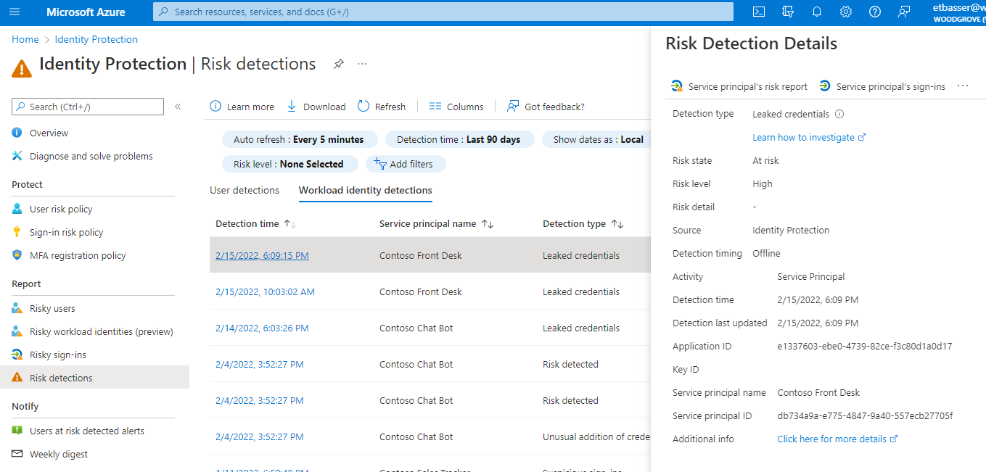
New tab in existing blade

Slide 46
Purpose-built detections for this account type

Slide 47
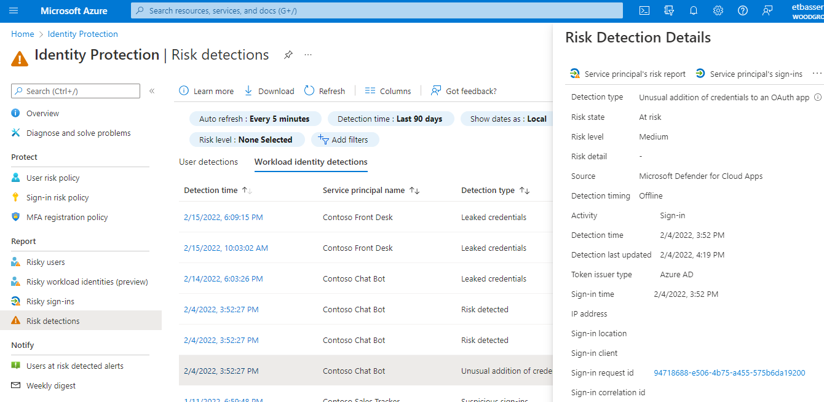
Familiar properties, adding in appID, keyID, SP info and URLs when appropriate

Slide 48
Configure a risk-based Conditional Access policy for workload identities

Slide 49
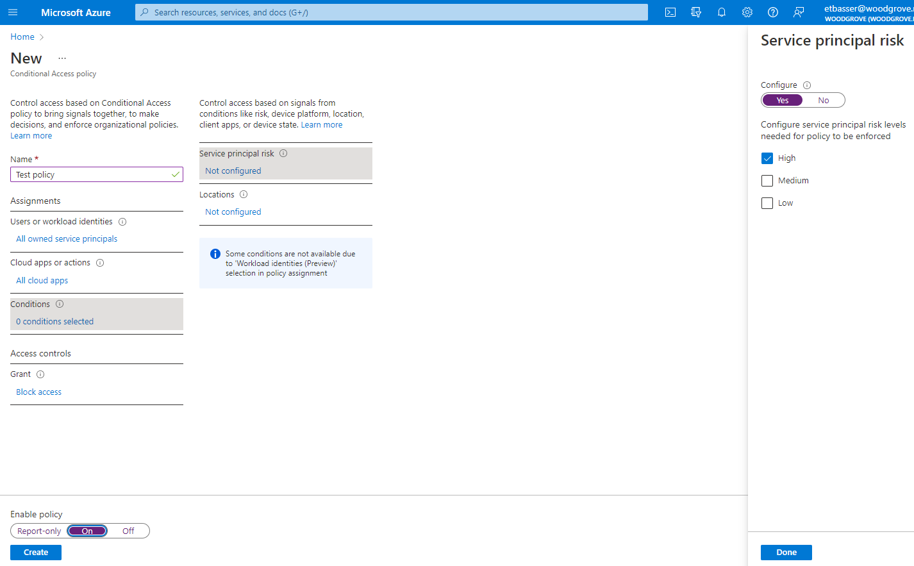
Select Service principal risk

Slide 50
Export risk data

Slide 51
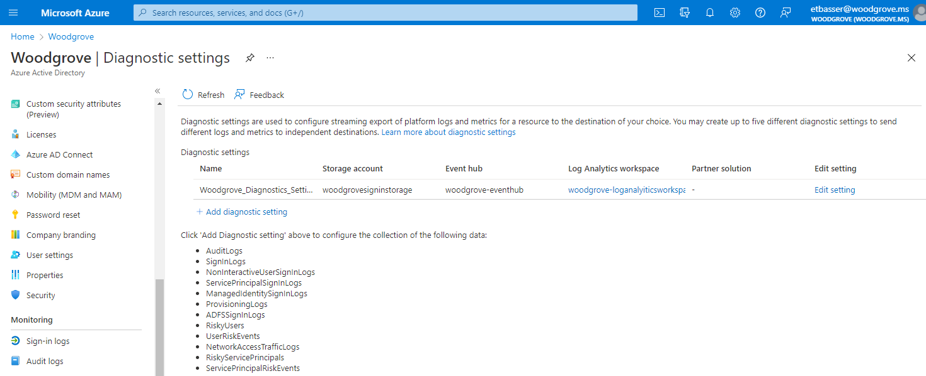
Two new data sources you can export

Slide 52
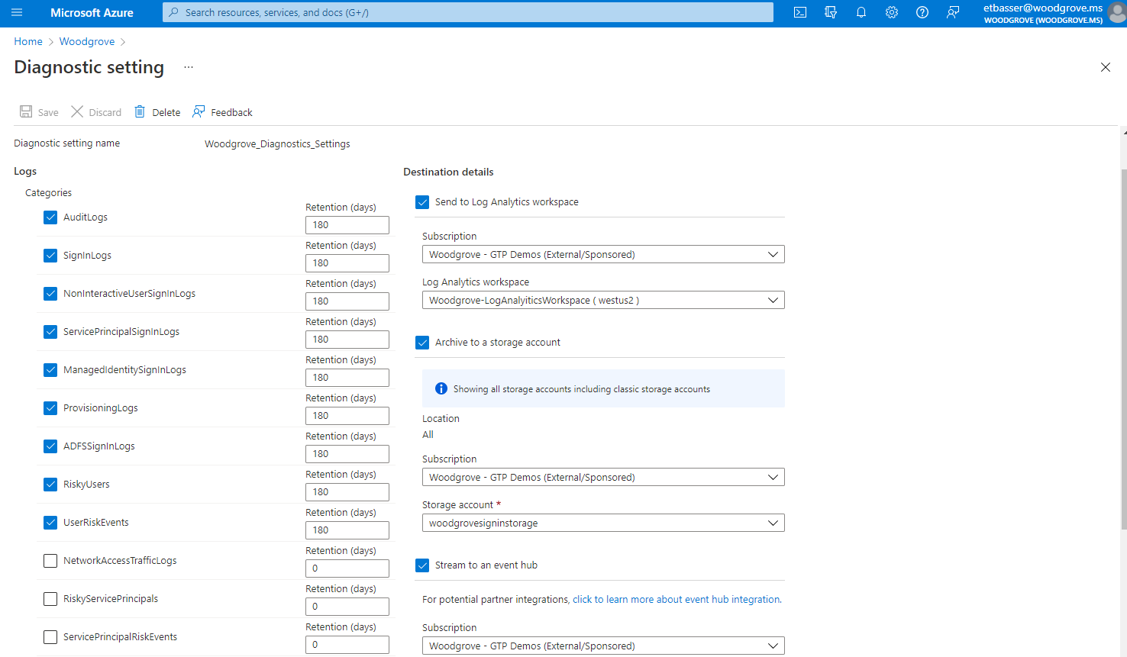
Check the box and specify the retention period (if storing)

Slide 53
Access reviews for workload identities assigned to privileged roles

Slide 54
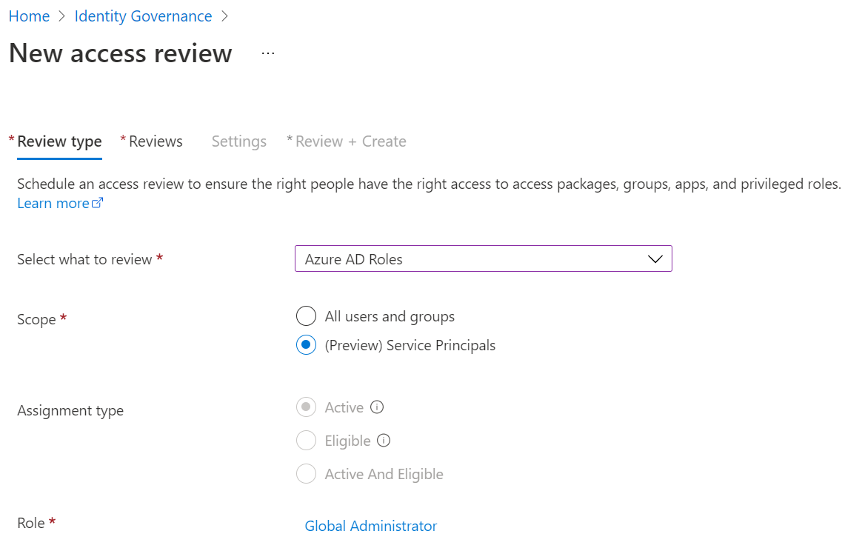

Access reviews for workload identities
​Schedule reviews of service principal assignment to Azure AD roles and Azure subscription roles
Delegate the reviews to the right people, then automatically revoke access of service principals denied by reviewers
Public Preview

Slide 55
Creating an access review for workload identities

Slide 56
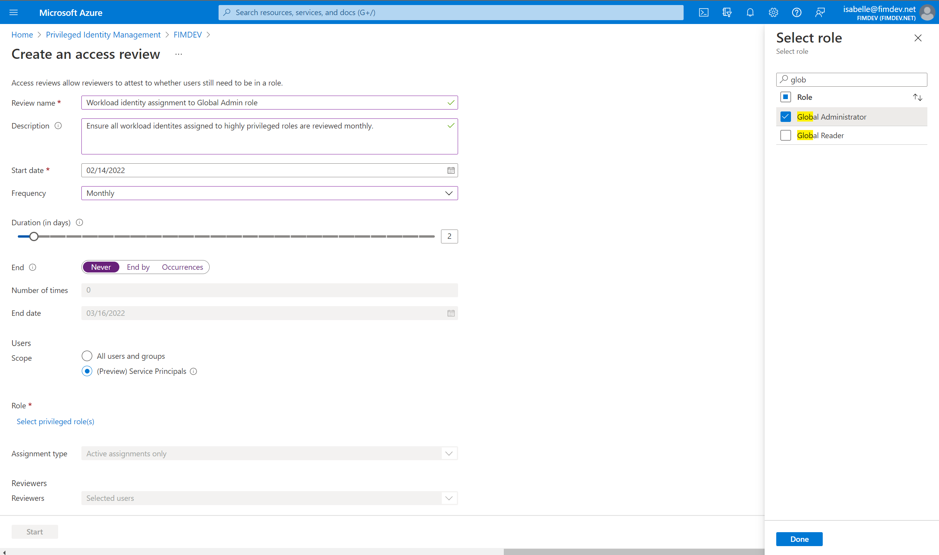
Name and describe the review​ series

Slide 57
Schedule the recurrence cycle​

Slide 58
Set the scope to Service Principals, then select the role

Slide 59
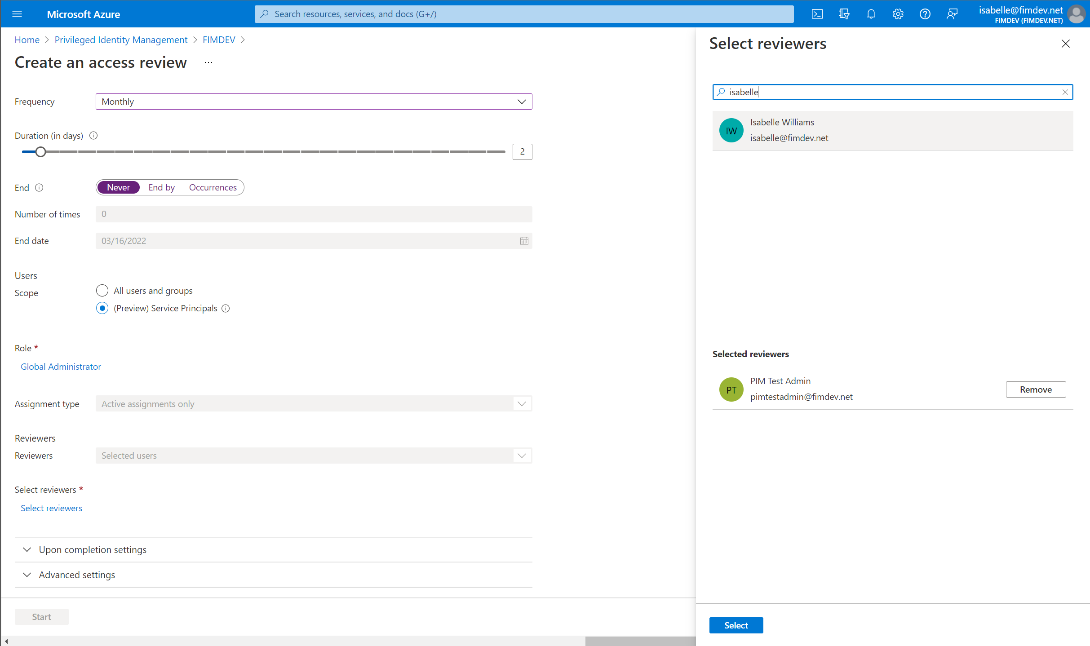
Select users or groups to review the service principals​

Slide 60
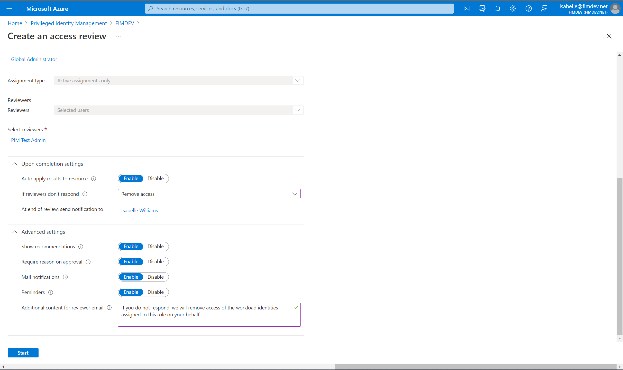
When each review recurrence ends, decide whether to automatically revoke access of denied and unreviewed assignments​

Slide 61
Configure additional settings, including how reviewers will be notified​
Create the review!

Slide 62
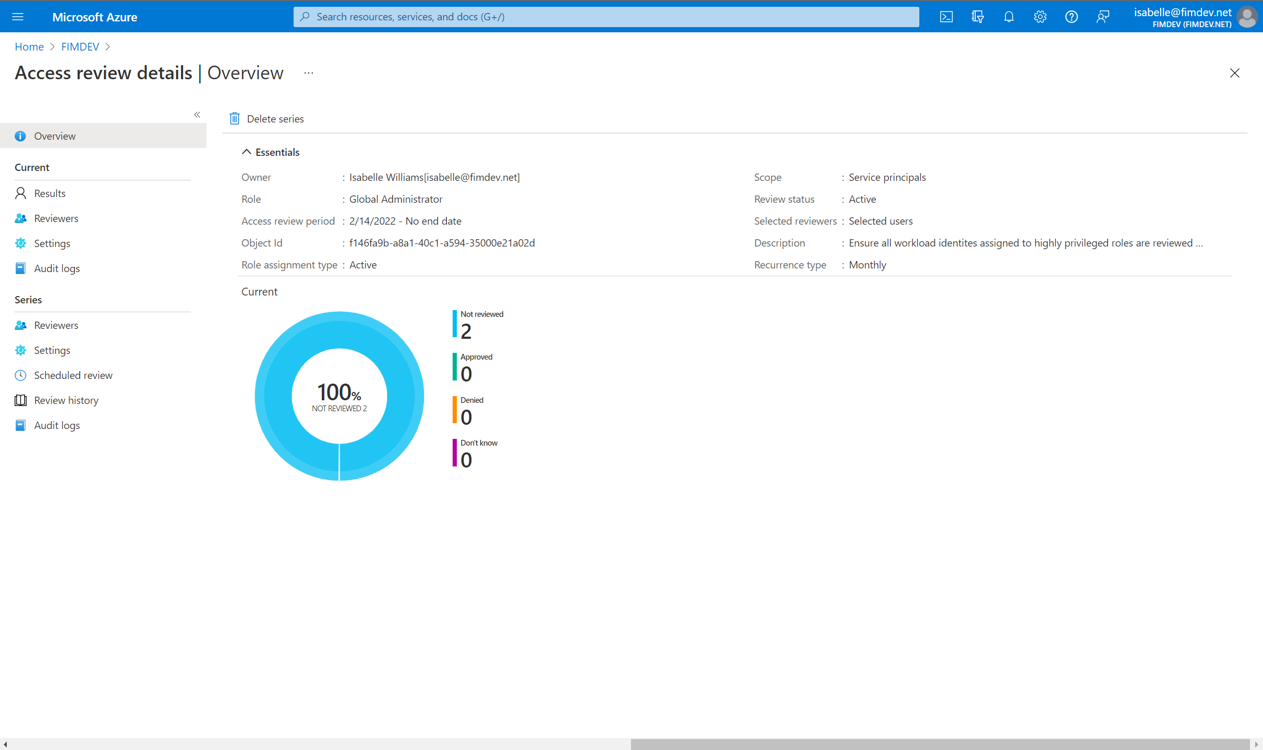

Slide 63
Workload Identity Federation

Slide 64
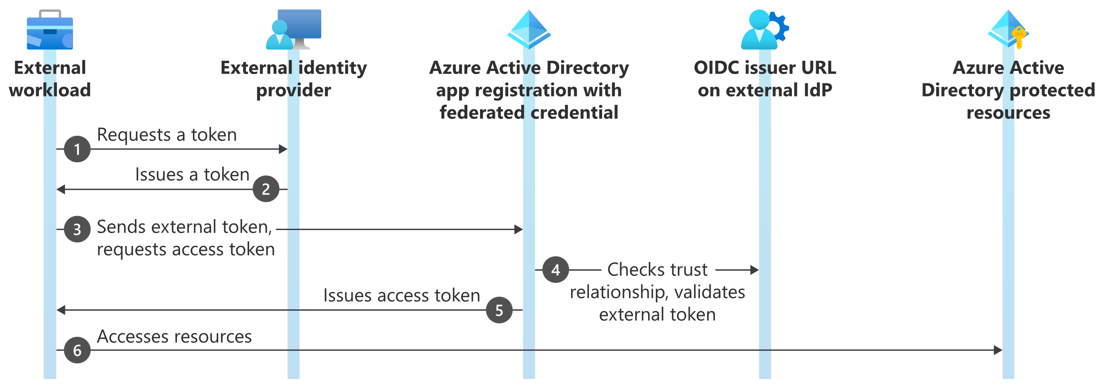
Workload Identity Federation
Allows you to access Azure Active Directory (Azure AD) protected resources without needing to manage secrets

Slide 65
Workload Identity Federation – Supported Scenarios
GitHub Actions
Google Cloud
Workloads running on Kubernetes
Workloads running in compute platforms outside of Azure

Slide 66
Resources

Slide 67
Takeaways
Detect attacks against workload identities
Control access based on risk
Export the risk data to the platform of your choice
Reduce risk and increase security by extending access reviews capabilities beyond user accounts
Federate workload identities – token based authentication

Slide 68
Resources
Microsoft docs pages:
Workload identities - Microsoft identity platform | Microsoft Docs
Workload identity federation - Microsoft identity platform | Microsoft Docs
Azure Active Directory Conditional Access for workload identities preview | Microsoft Docs
Create an access review of Azure resource and Azure AD roles in PIM - Azure AD | Microsoft Docs
Securing workload identities with Azure AD Identity Protection Preview | Microsoft Docs
Workload Federation – GitHub Actions Documentation:
Microsoft Documentation
GitHub Documentation
Jon Gallant GitHub Code

Slide 69
Thank you!

Slide 70
Questions?

